Slide 1
Evolutionary Game Theory and Population Genetics
Nico D’Angelo
ISC 4933 Fall 2019

Slide 2
Game Theory
Game theory is a framework used to model decision dynamics based on expected outcomes
A game is defined in terms of number of players n, and a set of strategies S (choices of actions) available to each player
Most commonly studied games are 2 player games
Games are typically represented in terms of payoff matrices Qn, which encode the expected reward/utility of choosing a particular action, based on the choice of the other player(s) in a round of the game

Slide 3
Zero-Sum Games
A game is called zero-sum if for each strategy, the expected utility to 1 player is the opposite of the expected utility to the other
In terms of the payoff matrices, entries are of opposite algebraic sign
A 2-player zero sum game is typically given in terms of a single payoff matrix, where one player’s strategies are represented by the rows, the other’s by the columns

Slide 4
Population Genetic Dynamics
Population genetic dynamics for infinite, panmictic sexually reproducing population in terms of haplotypes at 2 fully recombining loci, with 3 alleles each
Population genetic dynamics were simulated under weak selection s=0.01
Given an initial fitness matrix w and initial genotype frequencies each equal to 1/9
Fitness matrix w | A1 | A2 | A3
B1 | 1.02 | 1.03 | 0.99
B2 | 1 | 0.99 | 0.98
B3 | 1.01 | 1.04 | 1.02

Slide 5
Dynamics of a zero-sum coordination game
Payoff matrix Q given as (w-1)/s
Payoffs defined in terms of fitness values to ensure equivalency of dynamics
A coordination game is one in which the expected utility is the same for all players
These games converge to mixed strategy equilibria, where a set of actions (2 in this case) are assigned probabilities representing the frequencies with which they are played by a player over time
2 | 3 | -1
0 | -1 | -2
1 | 4 | 2

Slide 6
MWUA and Population genetics
The population dynamics across generations is given by multiplying each genotype frequency in the current generation by its fitness value, i.e. the corresponding entry in the fitness matrix, and
Values are then renormalized so that frequencies add to 1
The game-theoretic analogy is approximated (but not exactly replicated) using an algorithm called the multiplicative weights update or (MWUA)
MWUA scales a mixed strategy from one round by a factor related to the fitness matrix (and thus the genotype frequencies
This changes the probability that it is played in subsequent rounds
Algorithm taken from Chastain et al.

Slide 7
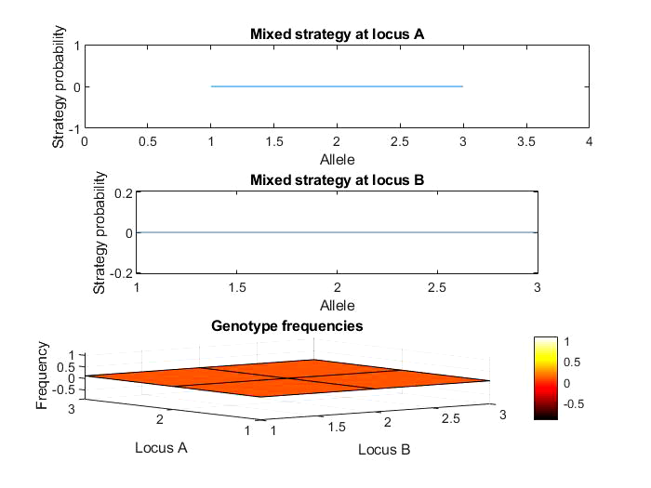
Genotype frequencies and Mixed Strategies over 100 generations

Slide 8
Discussion and Improvements
Game-theoretic and replicator dynamics are close, but not equivalent
The MWUA does not appear to converge to theoretical equilibria for the coordination game (as was expected)
Testing across more generations, different fitness/payoff matrices, and selection coefficients may reduce apparent errors
Deterministic dynamics used here, but random factors (i.e. genetic drift) can be accounted for using stochastic analogue
Multiplayer games could account for several loci and several alleles
Comparison to finite population size/noninfinite recombination more realistic

Slide 9
References
Chastain, E., et al. “Algorithms, Games, and Evolution.” Proceedings of the National Academy of Sciences, vol. 111, no. 29, 2014, pp. 10620–10623., doi:10.1073/pnas.1406556111.
Meir, Reshef, and David Parkes. On Sex, Evolution, and the Multiplicative Weights Update Algorithm. 2015. EBSCOhost, search.ebscohost.com/login.aspx?direct=true&db=edsarx&AN=edsarx.1502.05056&site=eds-live&scope=site.

